Slide 1
Healthify
Hackathon - edtech
By TechZ

Slide 2
Healthify
Introduction
“Healthify” is an app which provides a medium for effective communication between doctors and covid patients in home quarantine
Doctors can also keep track of the state of covid patients in home quarantine and submit the data for research
Tracking the new strains of the virus becomes more easier and faster, helping to contain the new strains more effectively.

Slide 3
Current situation
WHY HEALTHIFY?
Currently covid patients can be categorised into:
Category A: Mild rhinitis / sore throat / cough / diarrhoea
Category B: Fever and/or severe sore throat / cough / diarrhoea OR Category A plus any other co-morbidities (hypertension / uncontrollable diabetes / cancer / HIV AIDS / pregnancy / heart / lung / kidney / liver disease)
Category C: Patients with breathlessness / chest pain / hypotension / worsening of underlying chronic condition
90% of the patients in category A is admitted to home quarantine

Slide 4
Problems faced by patients in home quarantine
Why healthify?
Only community workers are attending to their needs right now
Lack of constant contact with a medical professional
Uncertainty about their conditions can cause panic and mental stress leading to emotional trauma
Often feel neglected
By using healthify, we can bridge the gap between doctors and patients

Slide 5
Need for an online platform for patient-centric information exchange
Why healthify?
Convenient for doctors as well as patients
Reduces the consultation time of doctors, thereby saving more lives!
People have a natural reluctance to visit hospitals during the pandemic, especially due to social distancing norms and general anxiety
Dependable worldwide online platform with faster response to the patients needs

Slide 6
Features of healthify
Doctors can keep an eye on patient’s vitals like:
Temperature
Pulse
Blood pressure
Saturation of oxygen (SpO2)
Sugar levels

Slide 7
Features of healthify
Can be even used in post covid scenario for other medical conditions
Healthify will enable the patient to report to their doctors any new symptoms or difficulties that they face. It will also let patients schedule appointments with doctors.
Separate login portals for doctors and patients

Slide 8
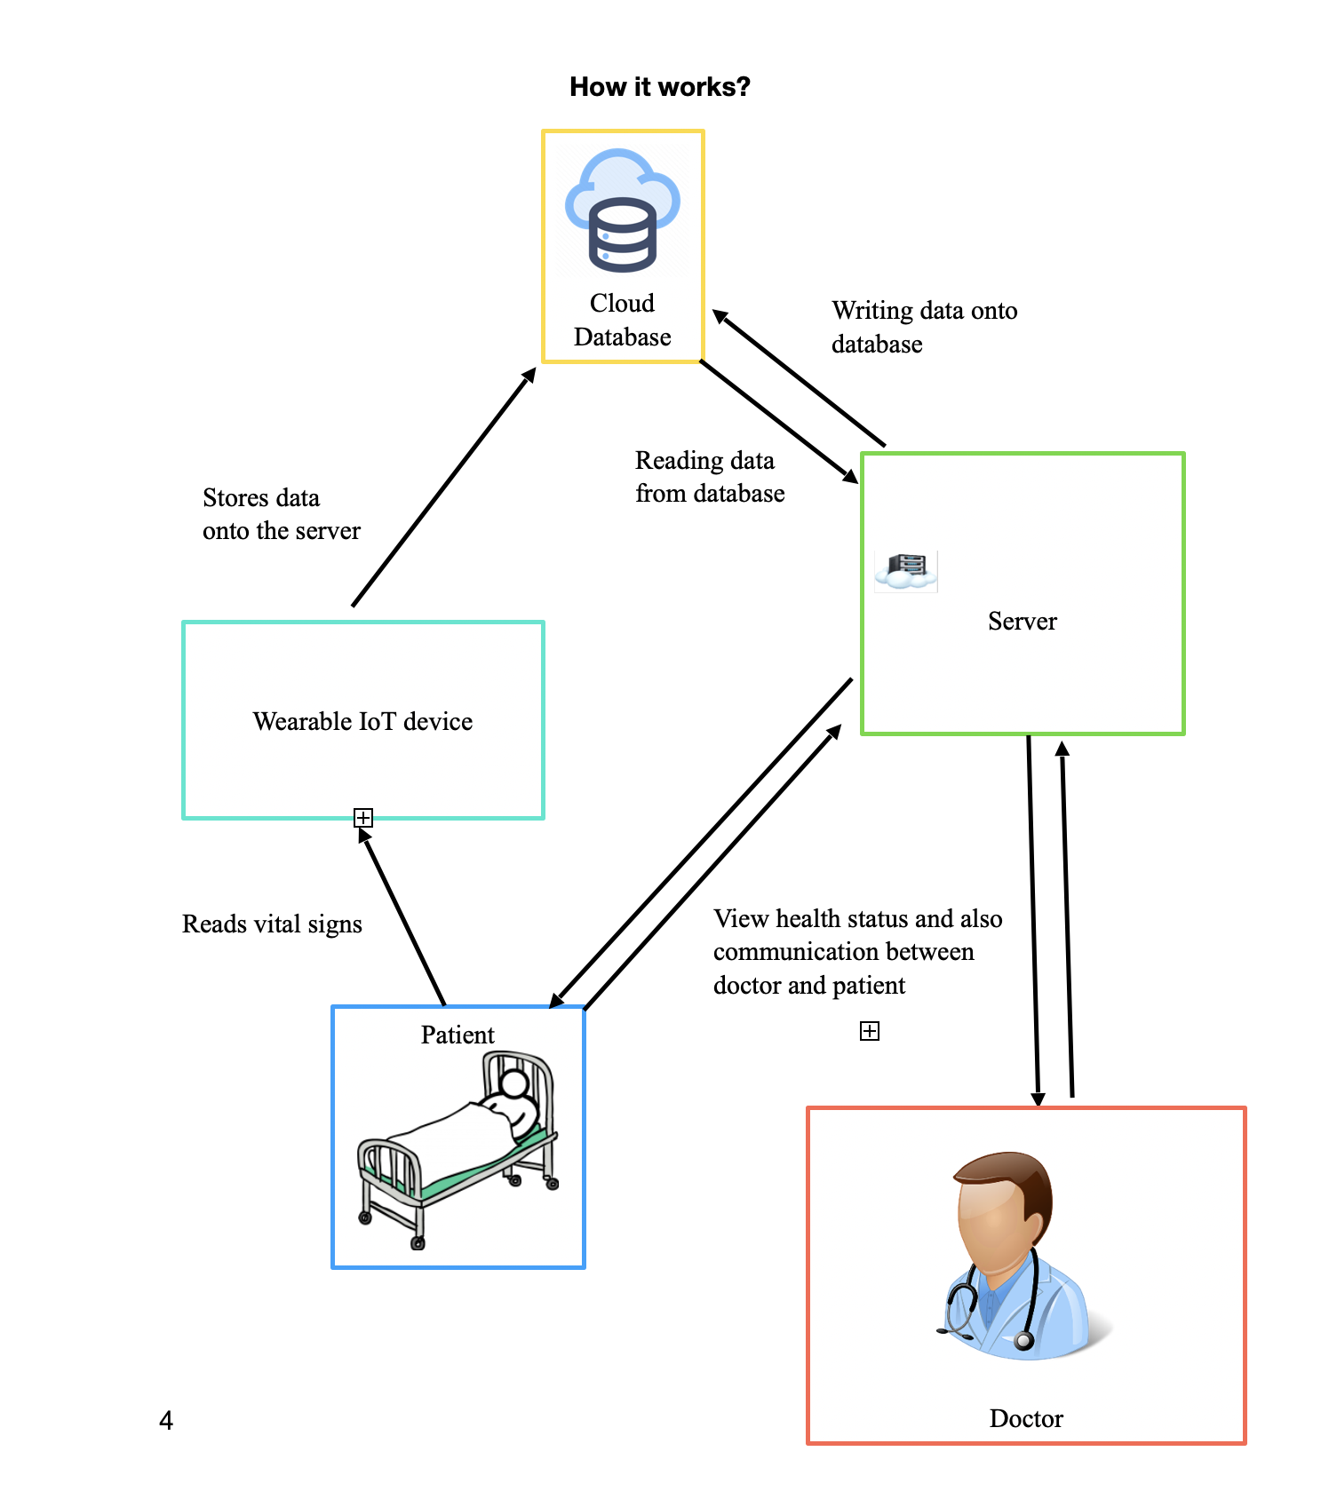
How can we implemented our ideas?
First, a package containing IoT devices which can take the reading of the above mentioned vital signs are shipped to the patient. These devices, when patients uses it, can send those data over the WiFi to the cloud server.
To ensure that the security of the data that we collected are not being compromised, we can encrypt the data while collecting and store the ciphered code on the cloud database.

Slide 9
A website is created and is hosted on a remote server. Website has access to the data stored on cloud database and cater to the following needs:
For patient : He/She can login to his/her account and see their health records. Server will also notify the patients if any data collected from them is not in the normal range. They can also communicate with the doctors assigned for them. Also, they can notify the doctor if they are suffering
For doctor: They can view the health status and past records of the patients, view their temperature, other vitals. They can be in contact with their patients and also pass on what needs to be done.

Slide 10
Also, we know that being in quarantine is tough and chances are high for one to feel alone and depressed. So, along with giving attention to COVID-19 patients in home quarantine we are providing mentoring for all such people. They can share their problems and personal mentors will get in touch with them.

Slide 11
How can we develop this project?
Front end can be developed using HTML5 and CSS
Client side - JavaScript (CSJS) and
Server side - JavaScript (SSJS) can be used an backend
MongoDB can be used as the cloud database

Slide 12
Necessity of healthify
The average budget of covid patients in hospital costs around 25k for one week
With healthify we provide an alternate solution with the same amount of attention from medical professional that we get in hospitals with very low cost

Slide 13
How is it different from a normal phone call / google meet with the patient?
It’s nearly impossible for doctors to keep track of every patients. By using healthify, covid patients get more attention than before.

Slide 14
Why should companies invest in our idea?
Most of the hospitals lose their category A patients to home quarantine which comprises of a major portion of all covid patients. Also by using healthify they get the same medical attention with a lower price which helps hospitals in keeping their patients. The first hospitals to invest in our idea will have a huge advantage over the others.

Slide 15
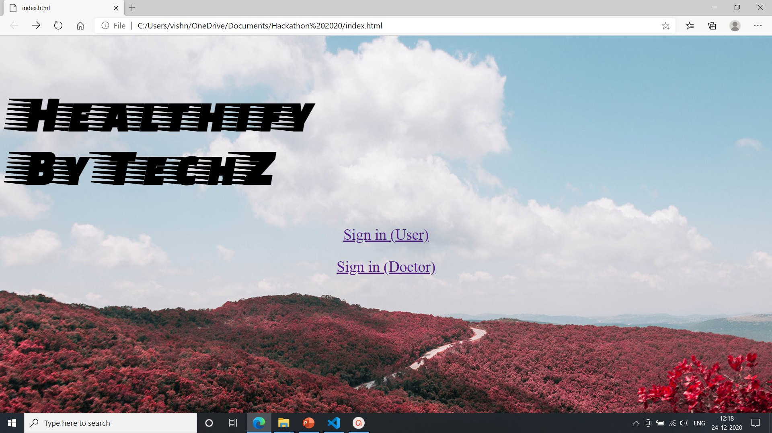
Screenshots of our project
Healthify

Slide 16
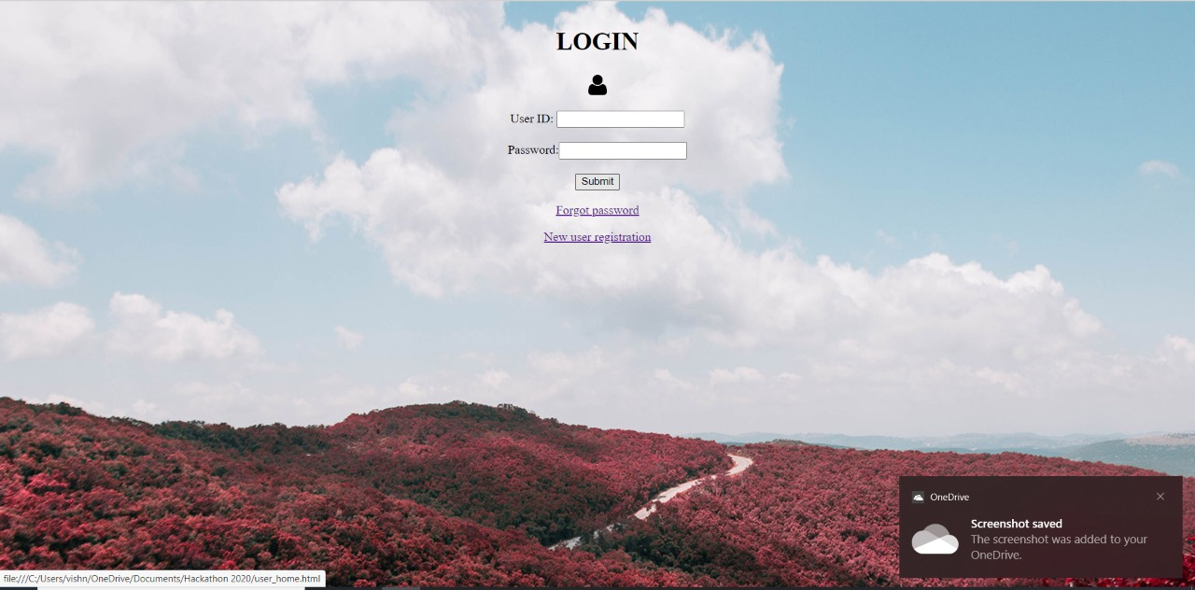
Login page (for user)

Slide 17
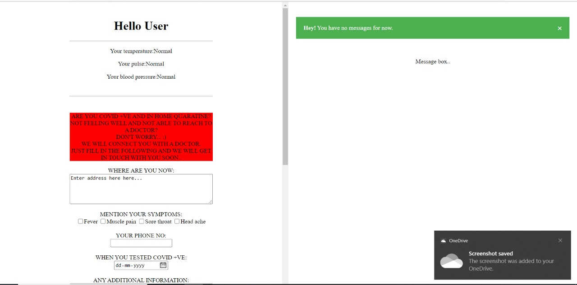

Slide 18
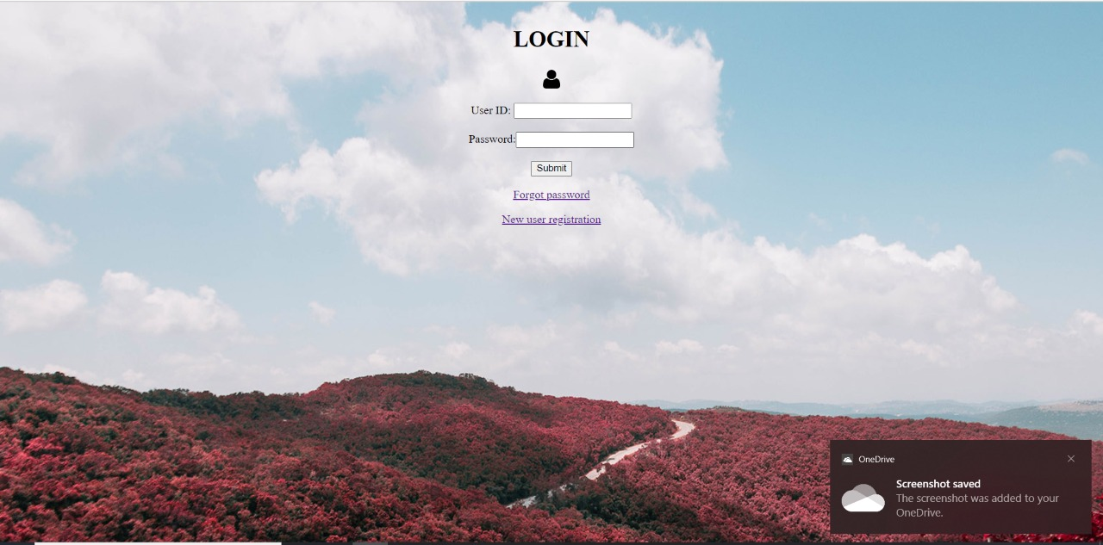
Login page (for doctors)

Slide 19
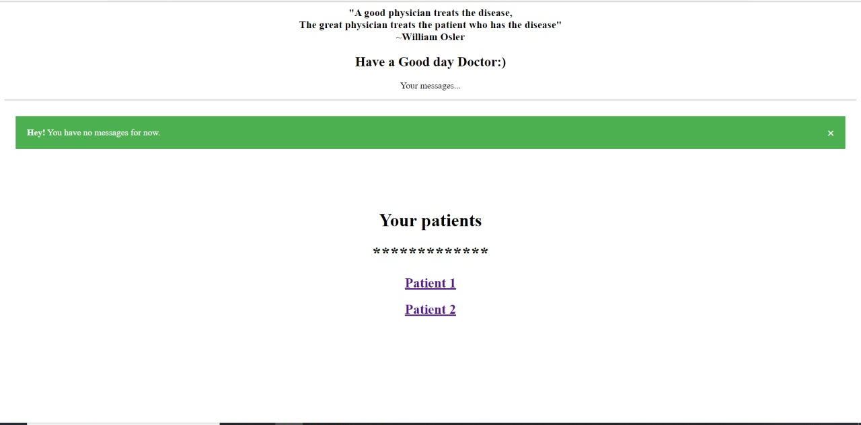

Slide 20
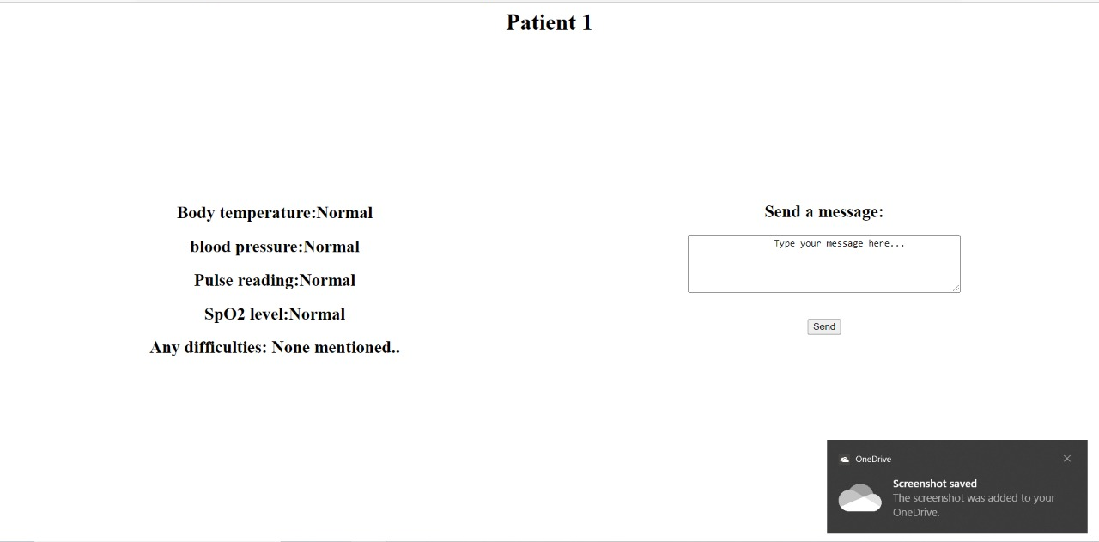

Slide 21


Slide 22
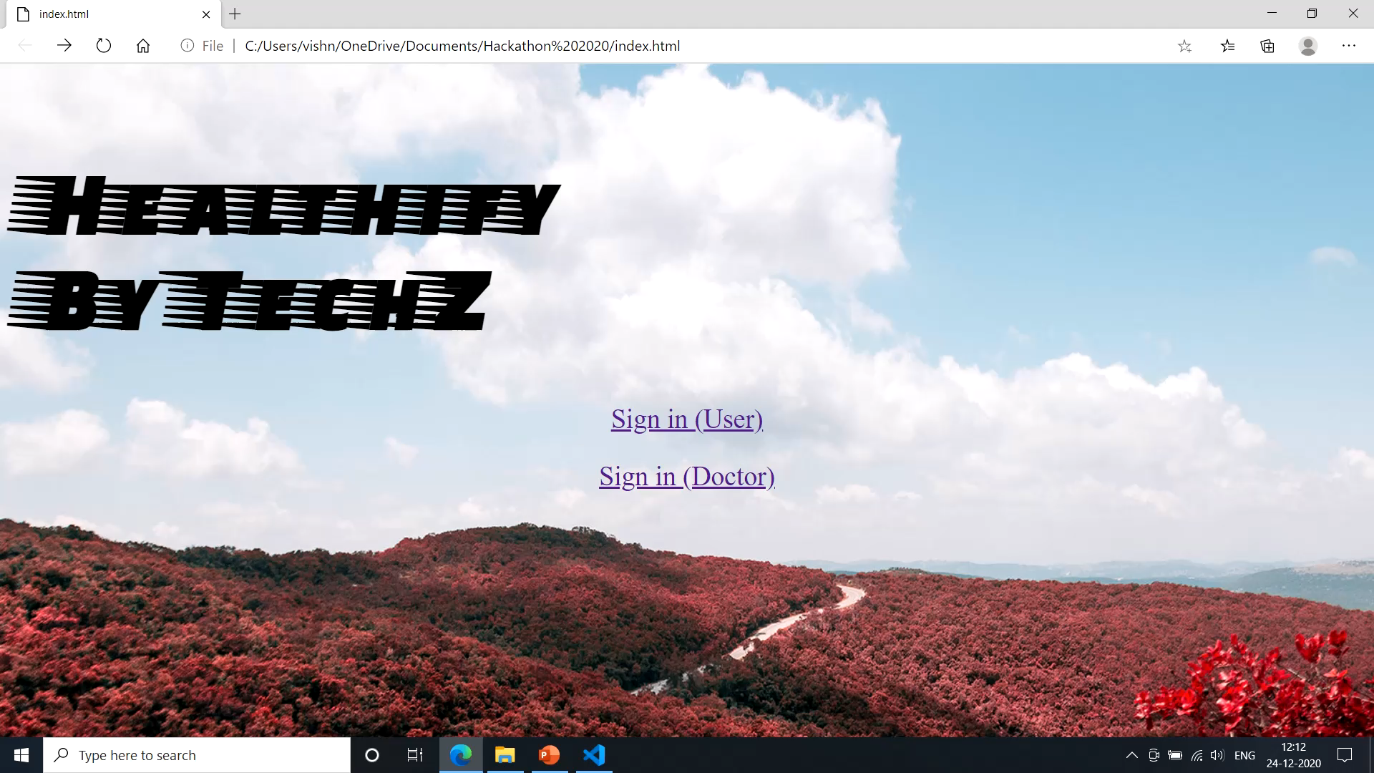

Slide 23

Thank you
By TechZ
Team members:
Mathew Abraham
Vishnu P
Arjun J

